Slide 1
PHRASAL VERBS (2)
Compiled by
CATHARINA STEPHEN

Slide 2
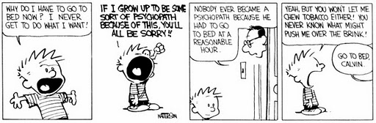
Grow up: “If I grow up to be..”
Most of you already know what "grow up" means: It's the process of becoming an adult - both physically and in terms of maturity... or simply to get older. What some of you don't know is that its use is limited. For example, it is incorrect to say: "My business is growing up". Similarly it is not possible to say, "I am growing up in knowledge". In both cases, just omit the preposition "up".
Notes:
G

Slide 3
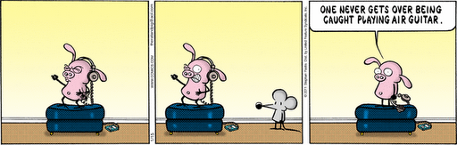
Get over something / someone
There are many meanings for this phrasal verb - but in this context it means to recover from something or feel better. Here the pig is saying that he will not recover from feeling humiliated or embarrassed.

Slide 4
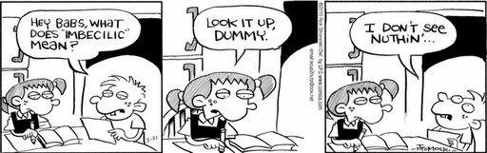
Look (something) up / Look it up
If you look someone or something up, you are looking for information from a reference source such as: the internet, the yellow pages, any kind of dictionary, an encyclopedia (or wikipedia), a telephone directory... facebook, Google Maps etc.

Slide 5
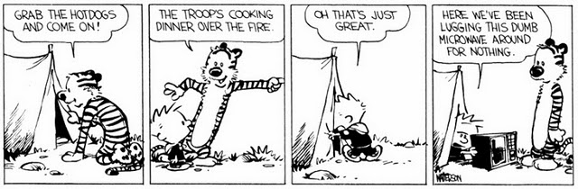
Lug (something) around
We've been lugging (this dumb microwave) around:
To pull or carry something that's heavy or cumbersome (big) with great difficulty.

Slide 6
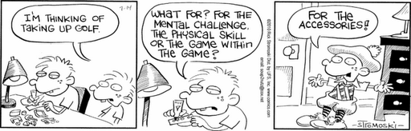
Take up something
If you take up something, you are starting a new hobby or activity.

Slide 7
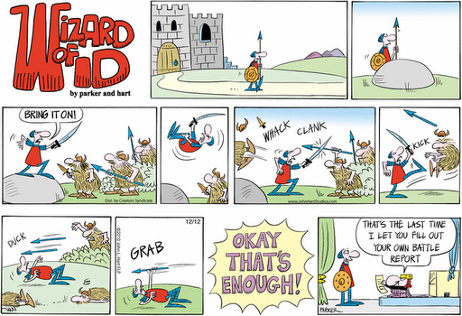
Fill out something
Usually you can fill out a form/ a document/ a questionnaire, a report or any kind of legal or official form. It is the same as saying "to complete in writing". Curiously, the phrasal verb "Fill in" is exactly the same as "Fill out"... they are synonyms.

Slide 8
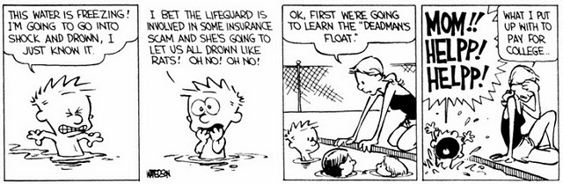
Put up with
If you put up with someone or something, you tolerate something that you don't like or something that irritates you.

Slide 9

What you’re up to
In this context, if you are up to something it simply means that you are doing something... you could also be scheming (secret plan).

Slide 10
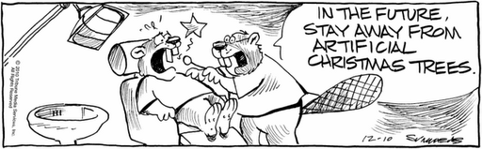
Stay away
If you need to stay away from something or someone, you should avoid it or them because it might be dangerous, risky or bad for you.

